Slide 1

Geometry
Unit 6, Lesson 12 Solving Problems Using Similarity – Part 2 Volume 1, pg. 358

Slide 2


Benchmark
MA.912.GR.1.6
Solve mathematical and real-world problems involving congruence or similarity in two-dimensional figures.
volume 1, pg. 358

Slide 3
Integrated Mathematical Thinking and Reasoning Standards
MA.K12.MTR.3.1 Complete tasks with mathematical fluency.
MA.K12.MTR.5.1 Use patterns and structure to help understand and connect mathematical concepts.
MA.K12.MTR.7.1 Apply mathematics to real-world contexts.
volume 1, pg. 358

Slide 4

Learning Target
I can solve real-world problems involving similarity in two-dimensional figures.
volume 1, pg. 358

Slide 5

Warm-Up
volume 1, pg. 359

Slide 6
6.12.1 Warm-Up: Biomedical Career
Liz Williams and Kate Lomas co-founded the Australian-based biomedical technology company, Hemideina. In Kate’s studies she found that the insect wētā has an amazing hearing system. Through her studies she invented an implant that can help those with hearing loss live a life without limits. (Video)
List at least one advantage that Kate may have had as an artist that helped her create her invention.
volume 1, pg. 359

Slide 7
Both Liz and Kate express excitement knowing that that their skills in science can be used to solve real-world problems.
What is one real-world problem that you think creativity, math, and science could be used to solve?
volume 1, pg. 359

Slide 8

Guided Instruction
volume 1, pg. 359

Slide 9
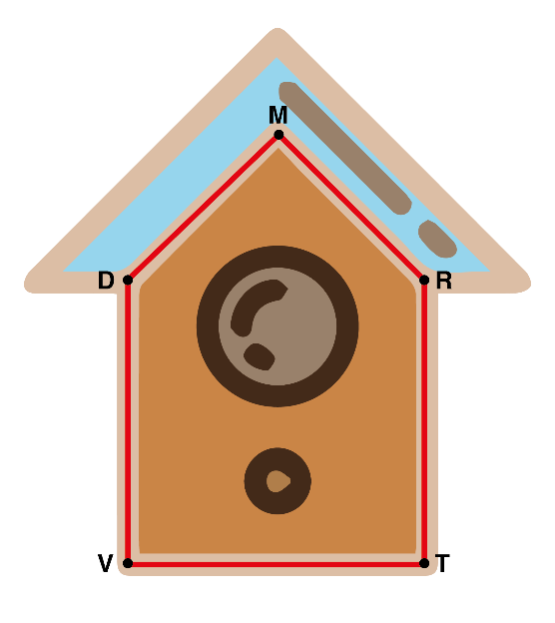
6.12.2 Guided Instruction: Similar Figures in the Real-World
Haley built a birdhouse by first drawing a blueprint. She then constructed the birdhouse using the dimensions from the blueprint. Her blueprint, 𝑃𝑆𝑊𝐺𝐵, and birdhouse, 𝐷𝑀𝑅𝑇𝑉, are shown.
volume 1, pg. 359

Slide 10
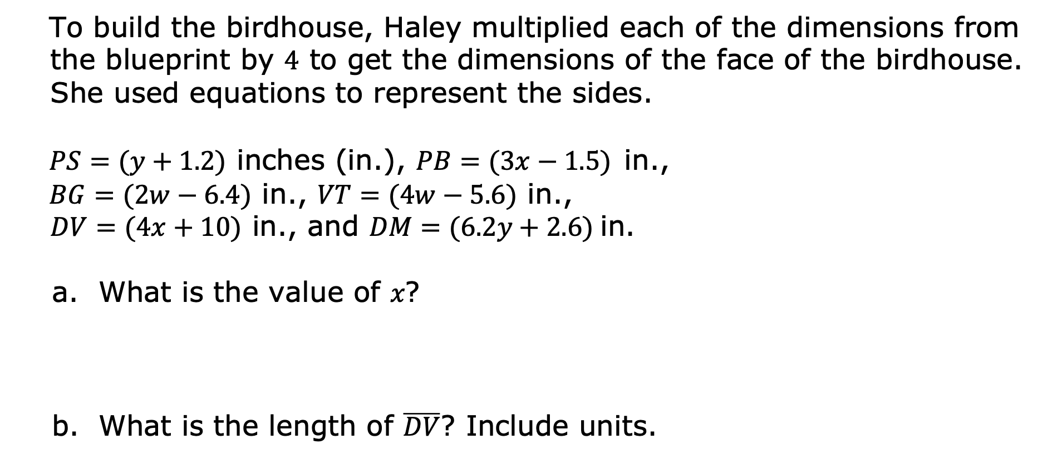
To build the birdhouse, Haley multiplied each of the dimensions from the blueprint by $4$ to get the dimensions of the face of the birdhouse. She used equations to represent the sides.
$PS=(y+1.2)$ inches (in.), $PB=(3x−1.5)$in.,
$BG=(2w−6.4)$ in., $VT=(4w−5.6)$ in., $DV=(4x+10)$ in., and $DM=(6.2y+2.6)$in.
What is the value of 𝑥?
What is the length of $\overline{DV}$? Include units.
volume 1, pg. 359

Slide 11

What is the value of 𝑦?
What is the length of $\overline{PS}$? Include units.
volume 1, pg. 360

Slide 12
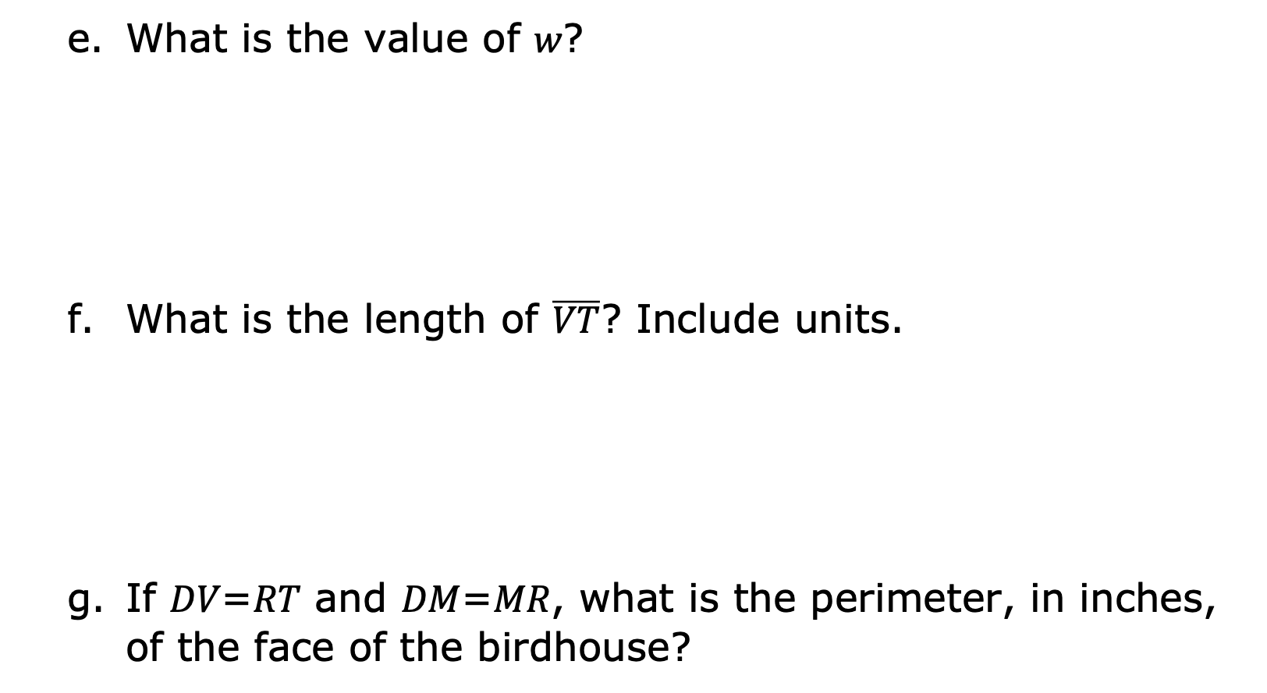
What is the value of 𝑤?
What is the length of $\overline{VT}$? Include units.
If 𝐷𝑉=𝑅𝑇 and 𝐷𝑀=𝑀𝑅, what is the perimeter, in inches, of the face of the birdhouse?
volume 1, pg. 360

Slide 13

Guided Practice
volume 1, pg. 360

Slide 14

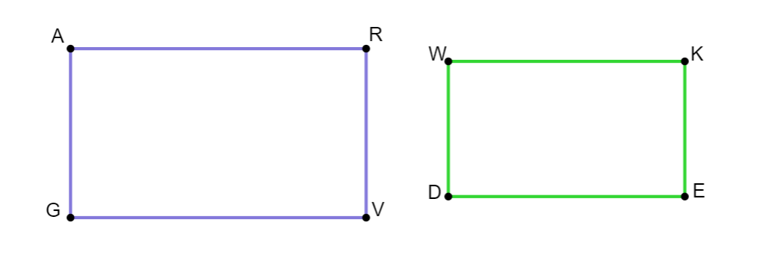
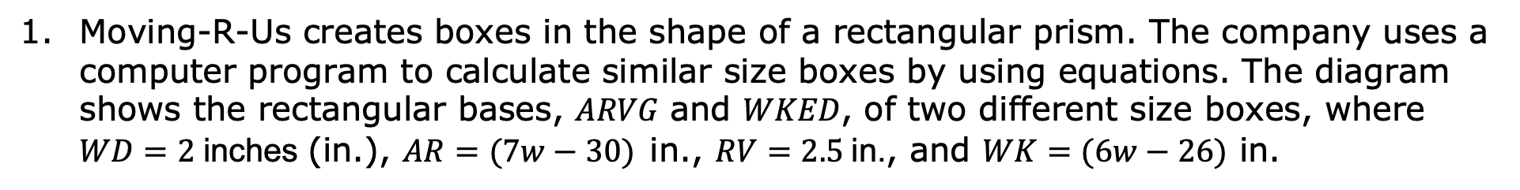
6.12.3 Guided Practice: Similar Figures in the Real-World
Moving-R-Us creates boxes in the shape of a rectangular prism. The company uses a computer program to calculate similar size boxes by using equations. The diagram shows the rectangular bases, 𝐴𝑅𝑉𝐺 and 𝑊𝐾𝐸𝐷, of two different size boxes, where $WD=2$inches (in.), $AR=(7w−30)$in., $RV=2.5$in., and $WK=(6w−26)$ in.
volume 1, pg. 360

Slide 15

What is the value of 𝑤?
What is the area of $ARVG$? Include units.
What is the perimeter of 𝑊𝐾𝐸𝐷? Include units.
volume 1, pg. 360

Slide 16
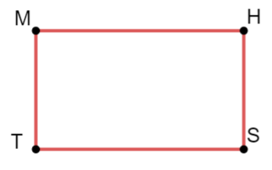
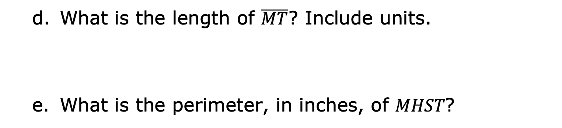
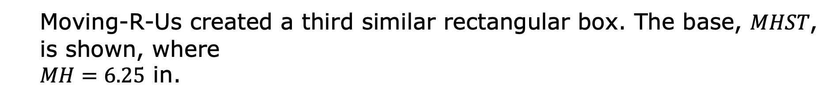
Moving-R-Us created a third similar rectangular box. The base, 𝑀𝐻𝑆𝑇, is shown, where $MH=6.25$ in.
What is the length of $\overline{MT}$? Include units.
What is the perimeter, in inches, of 𝑀𝐻𝑆𝑇?
volume 1, pg. 361

Slide 17

Try It
volume 1, pg. 361

Slide 18
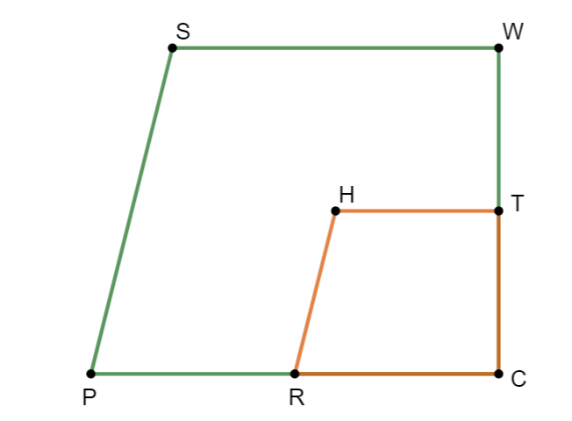
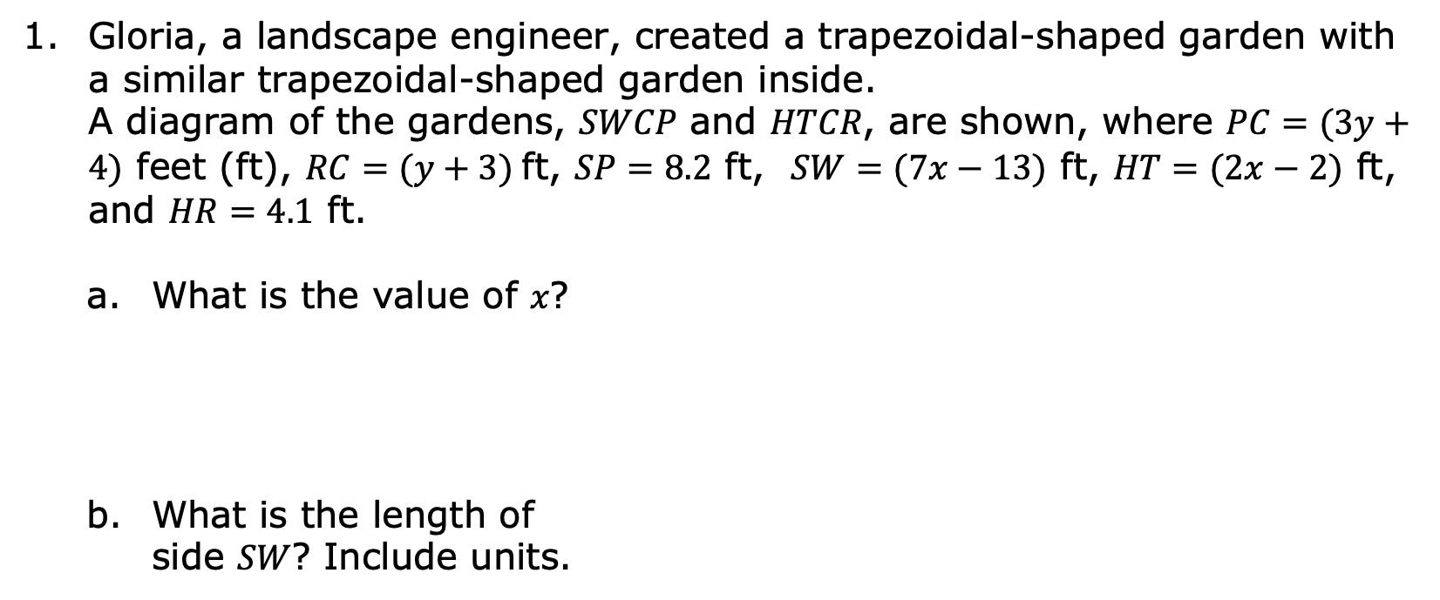
6.12.4 Try It: Solving in Real-World Context
Gloria, a landscape engineer, created a trapezoidal-shaped garden with a similar trapezoidal-shaped garden inside. A diagram of the gardens, 𝑆𝑊𝐶𝑃 and 𝐻𝑇𝐶𝑅, are shown, where $PC=(3y+4)$ feet (ft), $RC=(y+3)$ft, $SP=8.2$ ft, $SW=(7x−13)$ ft, $HT=(2x−2)$ ft, and $HR=4.1$ ft.
What is the value of 𝑥?
What is the length of side 𝑆𝑊? Include units.
volume 1, pg. 361

Slide 19

What is the value of 𝑦?
What is the length of side 𝑅𝐶? Include units.
If $SW=WC$, what is the perimeter, in feet, of the larger garden?
volume 1, pg. 361

Slide 20
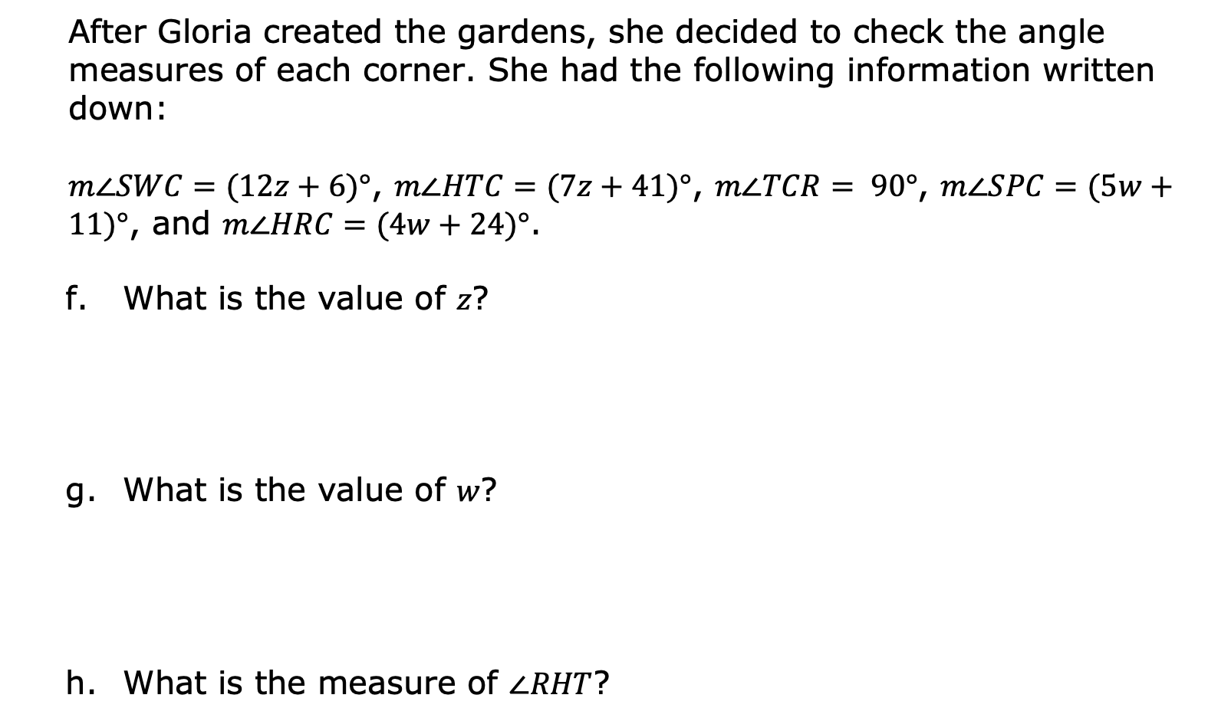
After Gloria created the gardens, she decided to check the angle measures of each corner. She had the following information written down:
$m∠SWC=(12z+6)°$, $m∠HTC=(7z+41)°$, $m∠TCR= 90°$, $m∠SPC=(5w+11)°$, and $m∠HRC=(4w+24)°$.
What is the value of 𝑧?
What is the value of 𝑤?
What is the measure of $∠RHT$?
volume 1, pg. 362

Slide 21

Wrap-Up
volume 1, pg. 362

Slide 22
6.12.5 Wrap-Up: Cool Down
Your friend is absent today and will need the notes from class. Write a quick note to let them know what they missed in today’s lesson.
volume 1, pg. 362

